Slide 1
Capstone Project - 3
Credit Card Default Prediction
Team Members Ritesh Rajurkar Bapu Bordekar

Slide 2

Content
Introduction
Problem Statement
Data Summary
Approach Overview
Exploratory Data Analysis
Modelling Overview
Feature Importances
Challenges
Conclusion

Slide 3
Introduction
In today’s world credit cards have become a lifeline to a lot of people so banks provide us with credit cards. Now we know the most common issue there is in providing these kind of deals are people not being able to pay the bills. These people are what we call “defaulters”.

Slide 4
Problem Statement
Predicting whether a customer will default on his/her credit card

Slide 5
Data Summary
X1 - Amount of credit(includes individual as well as family credit)
X2 - Gender
X3 - Education
X4 - Marital Status
X5 - Age
X6 to X11 - History of past payments from April to September
X12 to X17 - Amount of bill statement from April to September
X18 to X23 - Amount of previous payment from April to September
Y - Default payment

Slide 6
Approach Overview
Data Cleaning
Data Exploration
Modeling
Understanding and Cleaning
Find information on documented columns values
Clean data to get it ready for Analysis
Graphical
Examining the data with visualization
Machine Learning
Logistic
SVM
Random Forest
XGBoost

Slide 7
Basic Exploration
Dataset for Taiwan.
Data for 30000 customers.
6 Months payment and bill data available.
No null data.
9 Categorical variables present.

Slide 8
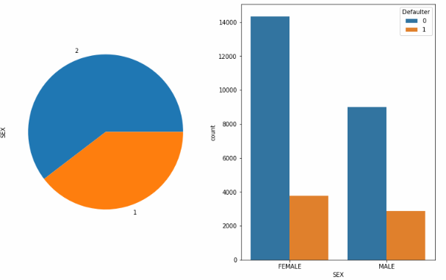
Gender Distribution

Slide 9
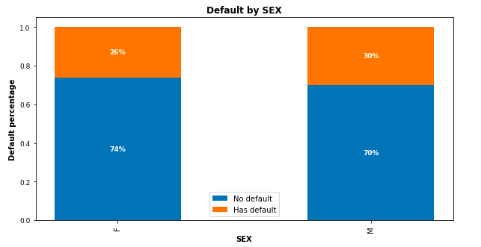
Gender wise defaulters
30% of Males and 26% of Females are defaulters

Slide 10
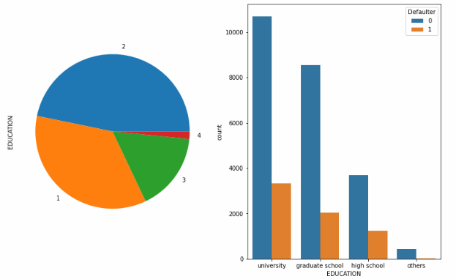
Education Distribution

Slide 11
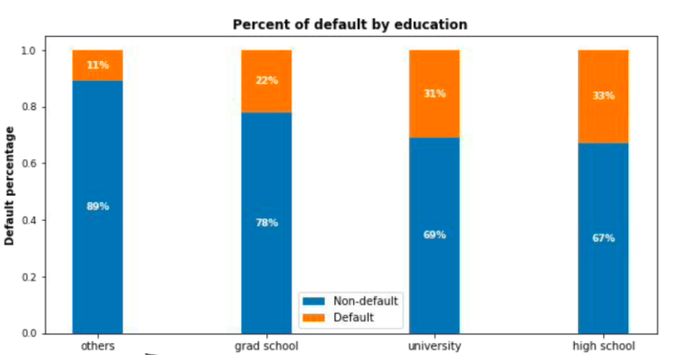
Education wise defaulters
Higher Education level, lower Default Risk

Slide 12
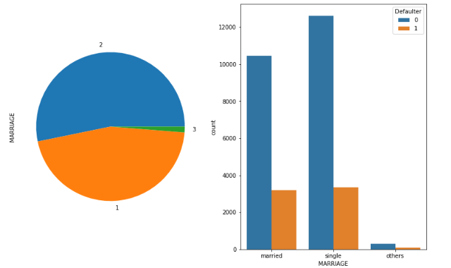
Marital Distributions

Slide 13
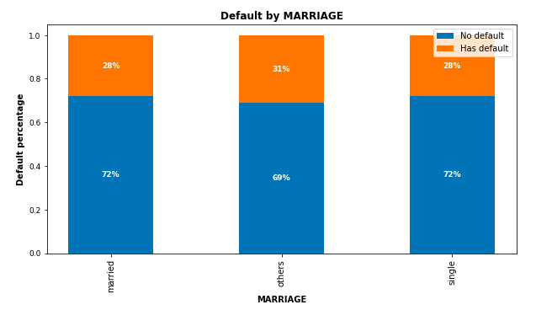
Marital Status
No Significant correlation of default risk and marital status

Slide 14
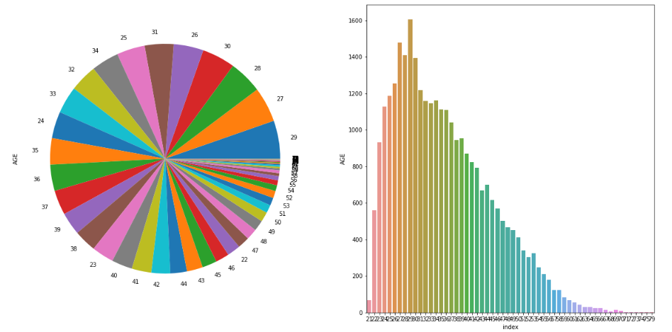
Age Distribution

Slide 15
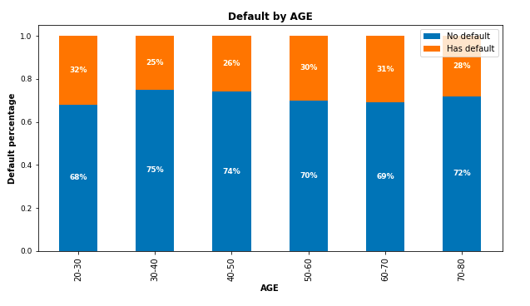
Age wise defaulters
30 t0 50:
Lowest Risk
<30 and >50:
Risk Increases

Slide 16
Modeling Overview
Supervised learning/Binary Classification
Imbalance data with 78% non-defaulters and 22% defaulters
Models Used:
Logistic Regression
Knn
Decision Trees
Random Forest
SVM
XGBoost
Naive Bayes

Slide 17
Modeling Steps
Model Evaluation
Data Preprocessing
Data Fitting and Tuning
Feature selection
Feature engineering
Train test data split(80%-20%)
SMOTE oversampling
Start with default model parameters
Hyperparameter tuning
Measure RUC-AOC on training data
Model testing
Precision_Recall Score
Compare with the other models

Slide 18

Logistic Modelling
Parameters :
C = 0.01
Penalty = L2

Slide 19
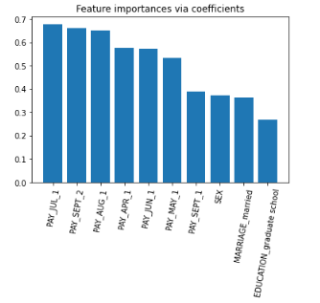
Logistic feature importances

Slide 20

SVM Modelling
Parameters
C = 10
Kernel = ‘rbf’

Slide 21

Random Forest Metrics
Parameters :
max_depth=30
n_estimators=150

Slide 22
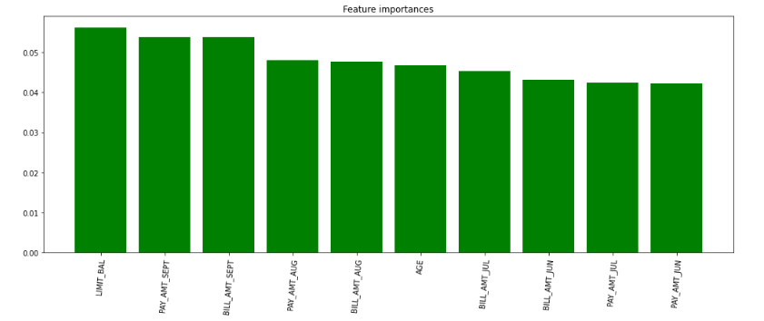
Random Forest feature importances

Slide 23

XGBoost Modelling
Parameters :
max_depth= 15
min_child_weight= 8

Slide 24
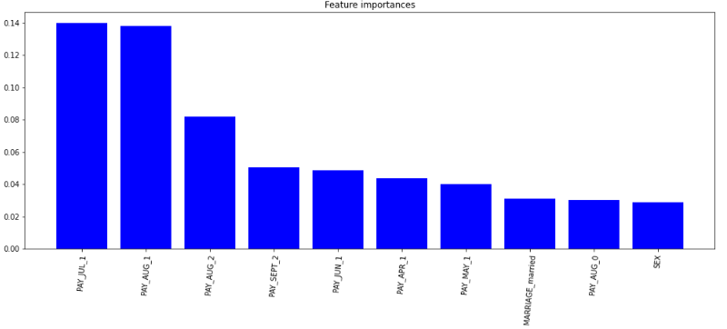
X Gradient Boosting feature importances

Slide 25
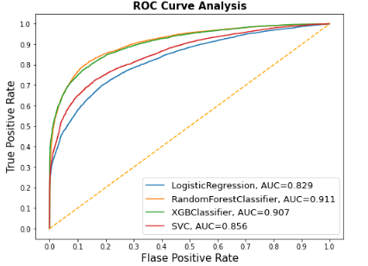
AUC-ROC curve comparision

Slide 26
Challenges
Understanding the columns.
Feature engineering.
Getting a higher accuracy on the models.

Slide 27
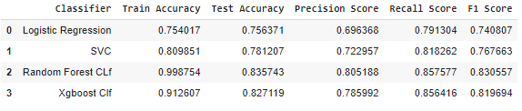
Conclusion
XGBoost provided us the best results giving us a recall of 85 percent(meaning out of 100 defaulters 85 will be correctly caught by XGBoost)
Random Forest also had good score as well but leads to overfit the data.
Logistic regression being the least accurate with a recall of 79.

Slide 28
Thank You

